Slide 1
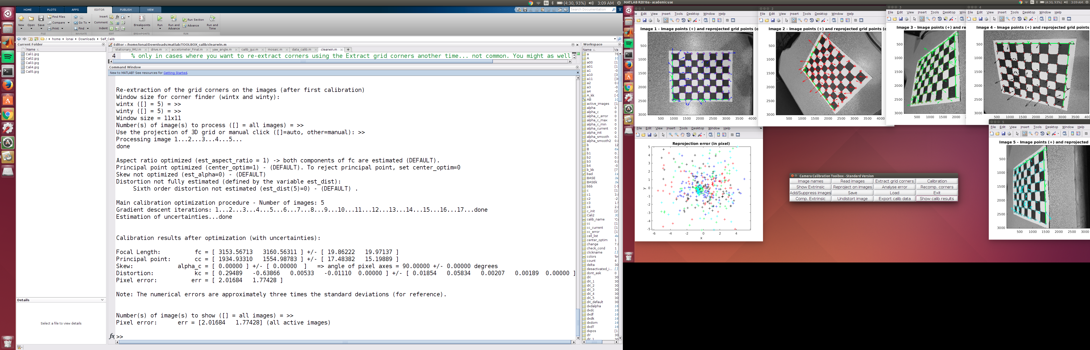
Self Calibration
Here I took 5 images for self calibration. The images reposition pixel error was reduced to 0.2788 & 0.2988 after reducing wintx & winty to 1. The window reduction has to be carried out incrementally while reducing pixel error.

Slide 2
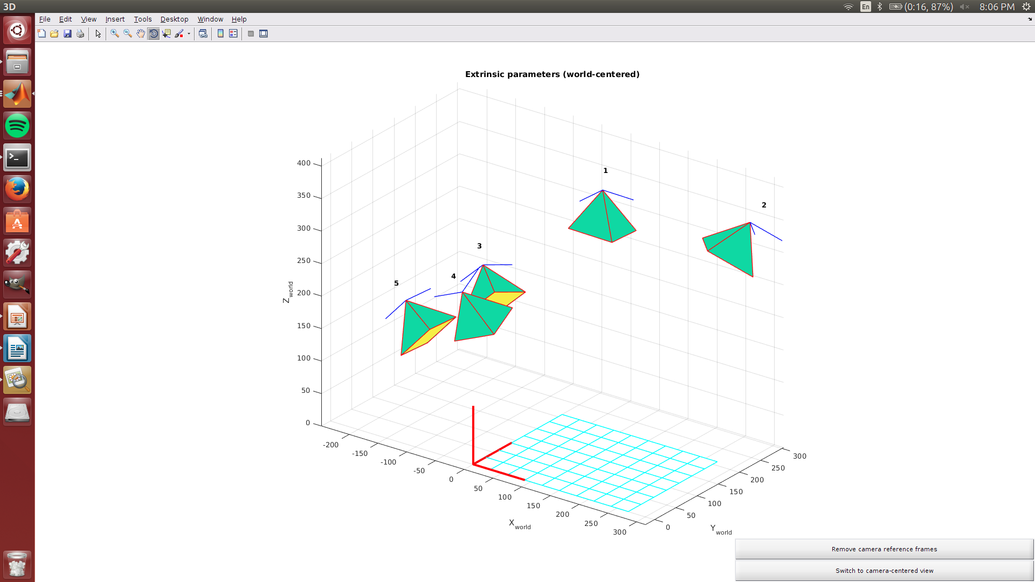
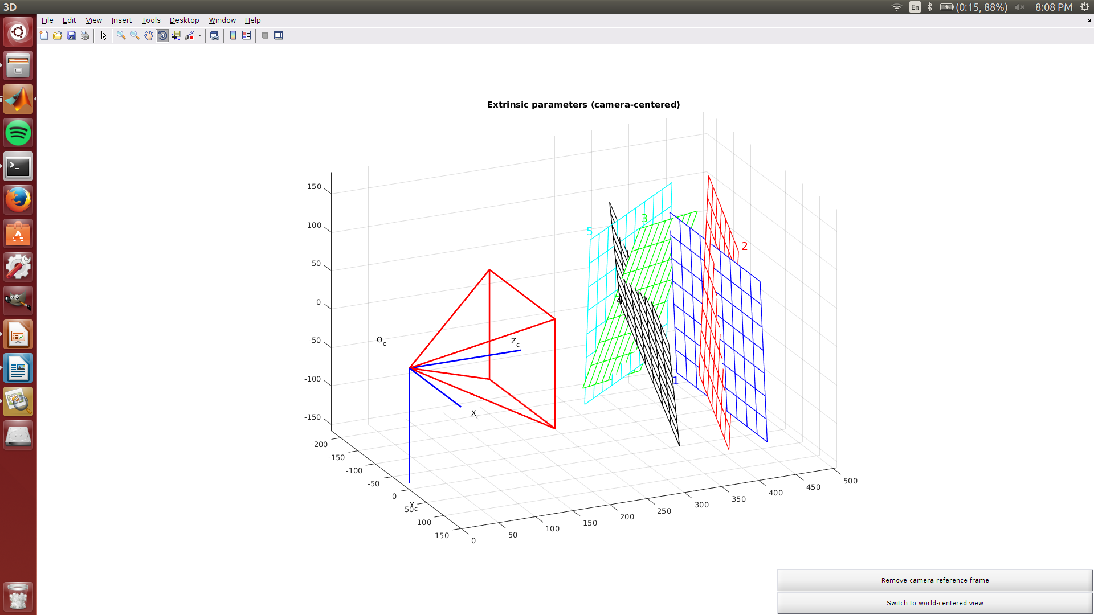
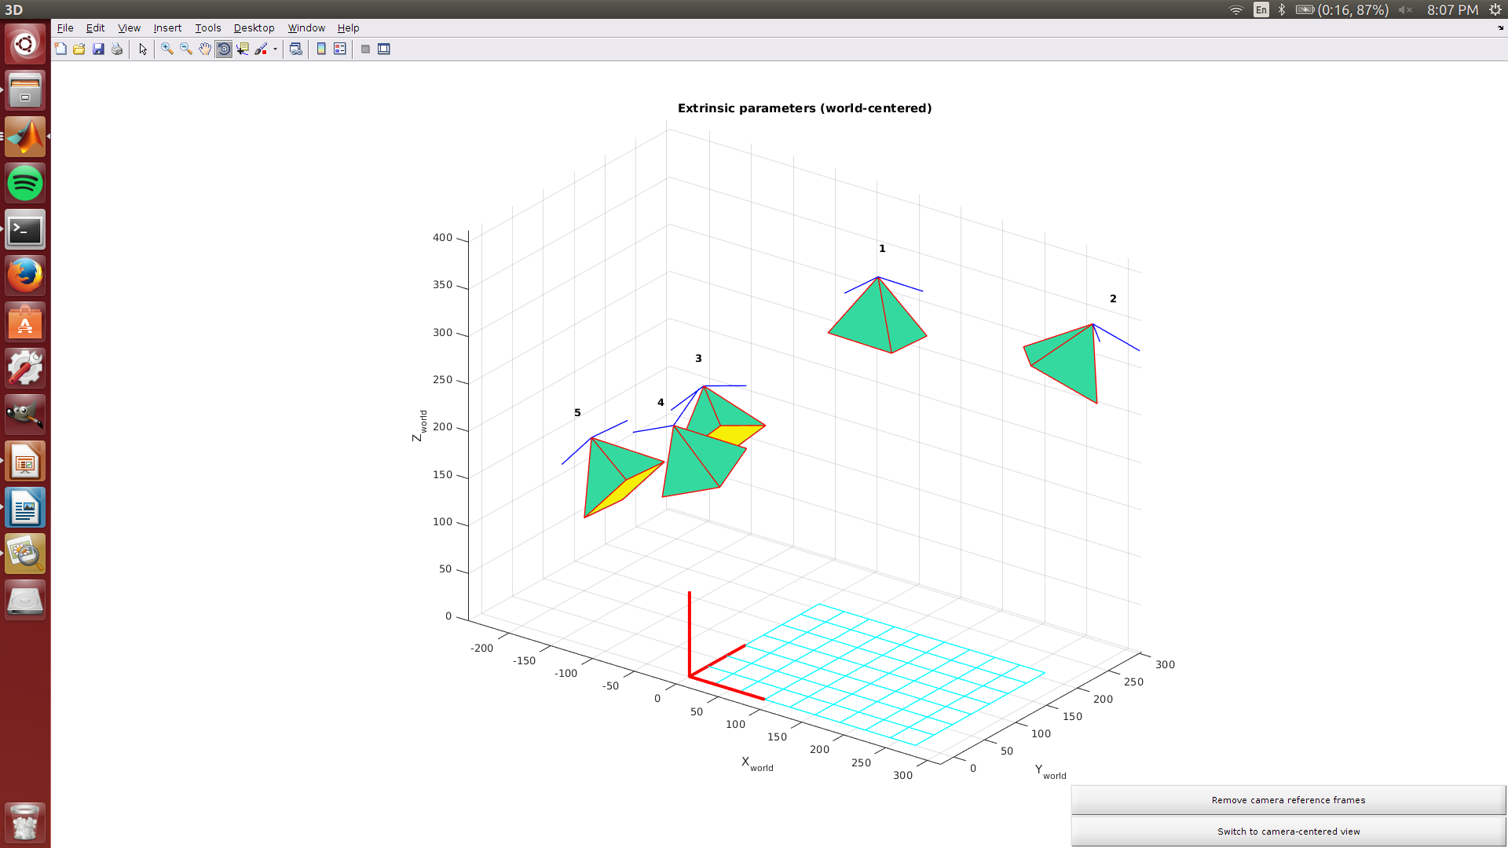
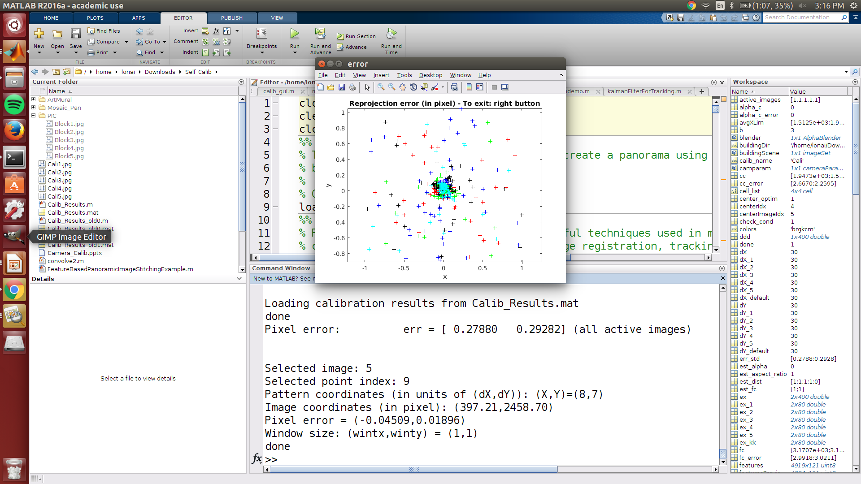
Error Position
Extrinsic parameters show the camera angle view with respect to the images taken
Reprojection error for window size of 1x1 have a reduced pixel for panorama stitching

Slide 3
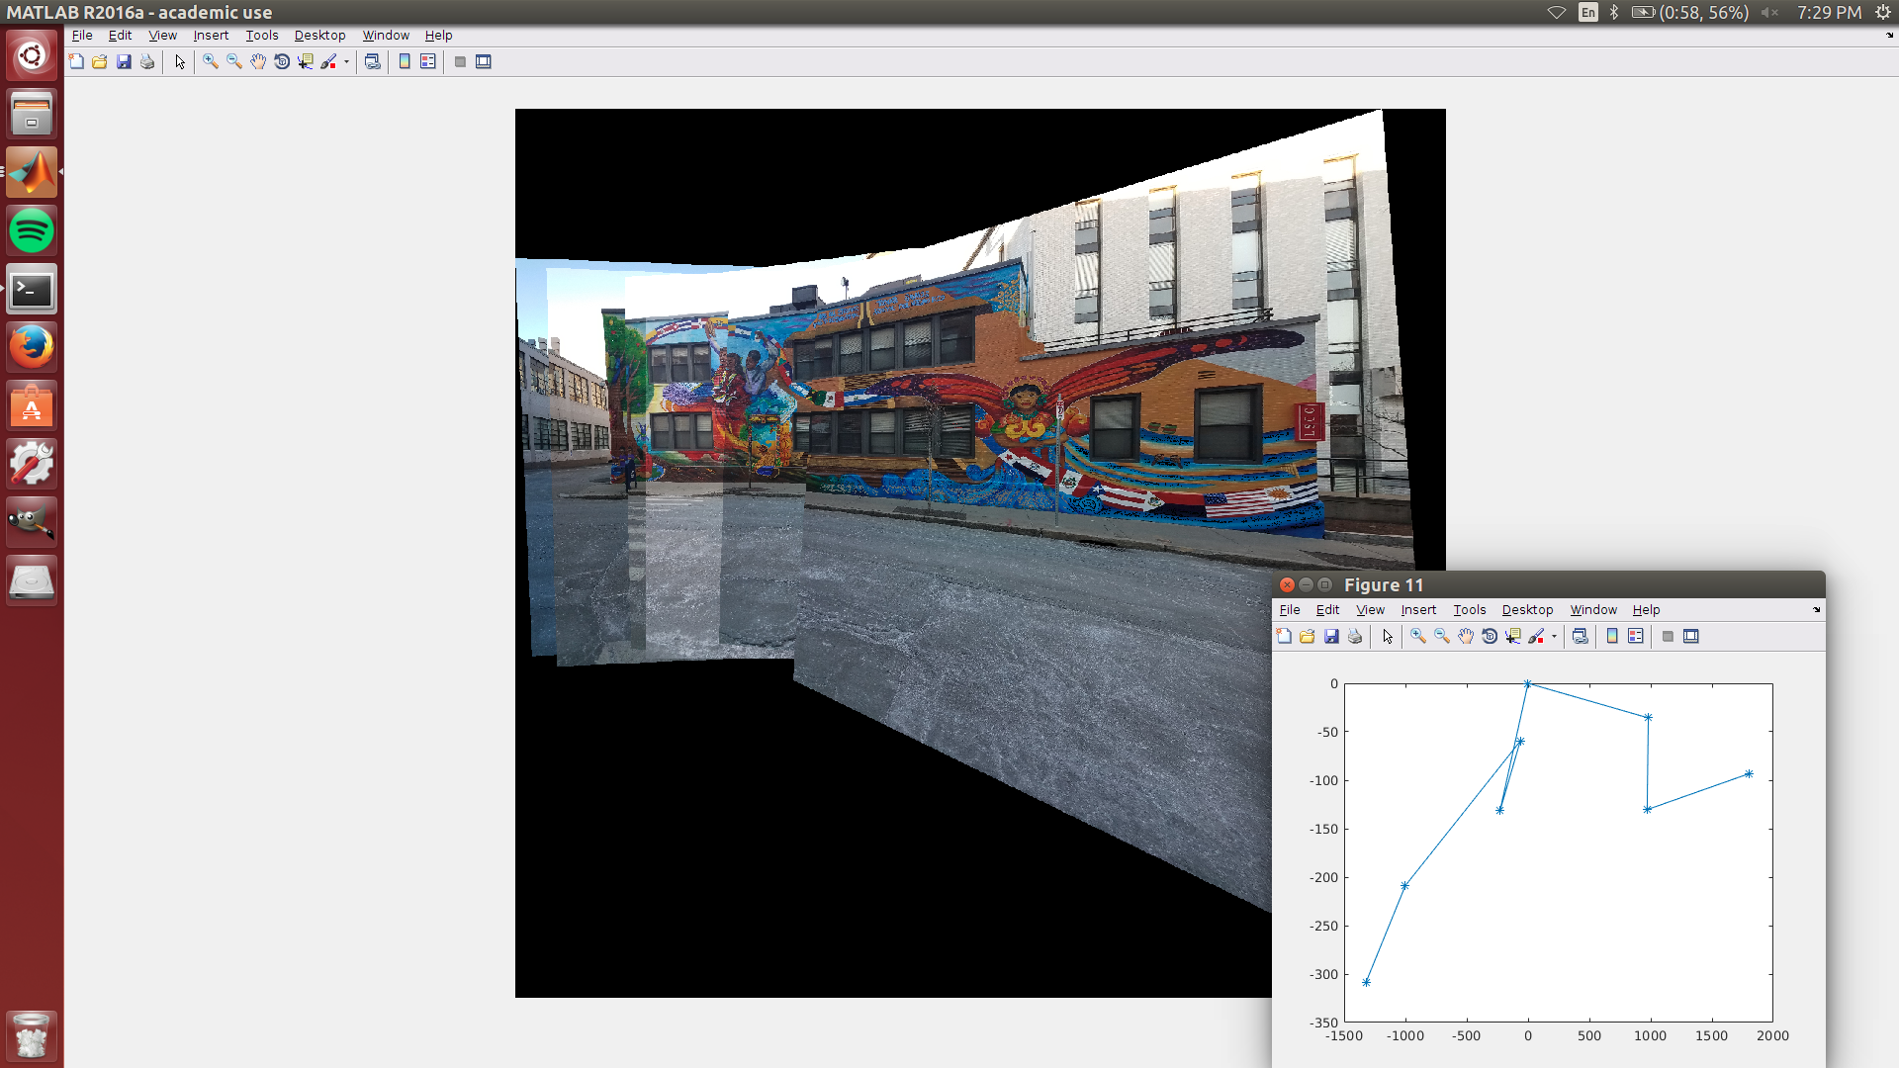
Latino Building
Here the panorama has been stitched to form the complete image.The camera position has been referenced with the 6th image being the image I came closest to the building and the first image the furthest.Images were taken with 40%-70% overlap and side by side the building in the background cannot be taken in the same image as that would distort the panorama. Change of angle of the camera also doesnt' affect the picture that much.

Slide 4
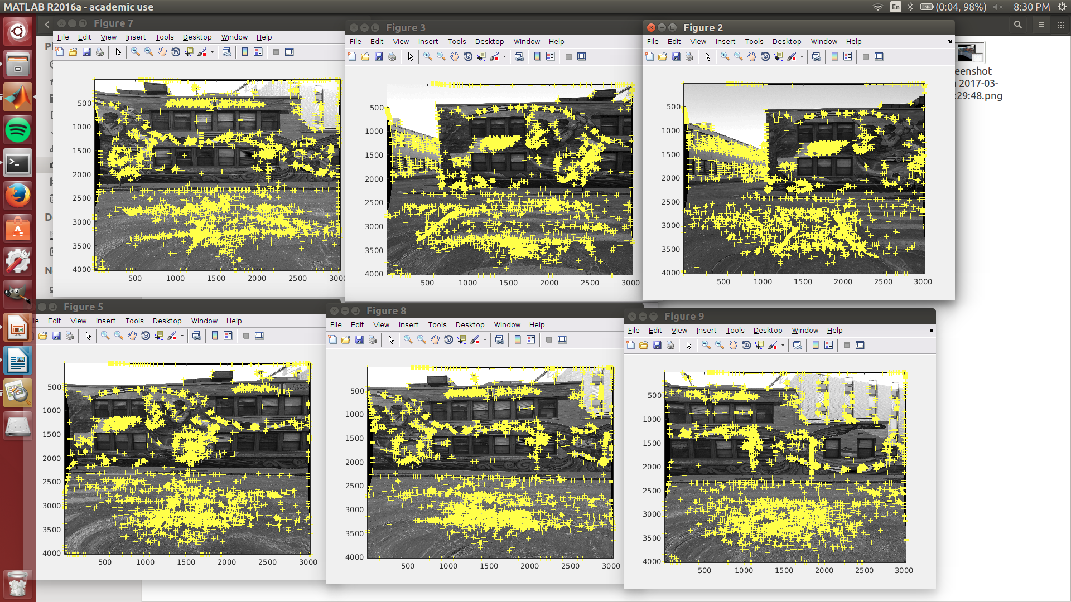
Harris Corner detection
Here I am detecting about 5000 points per image for the panorama stitching of the structure. The images were converted from RGB to gray for corner checking with respect to black and white points. I have used a total of 8 images.

Slide 5
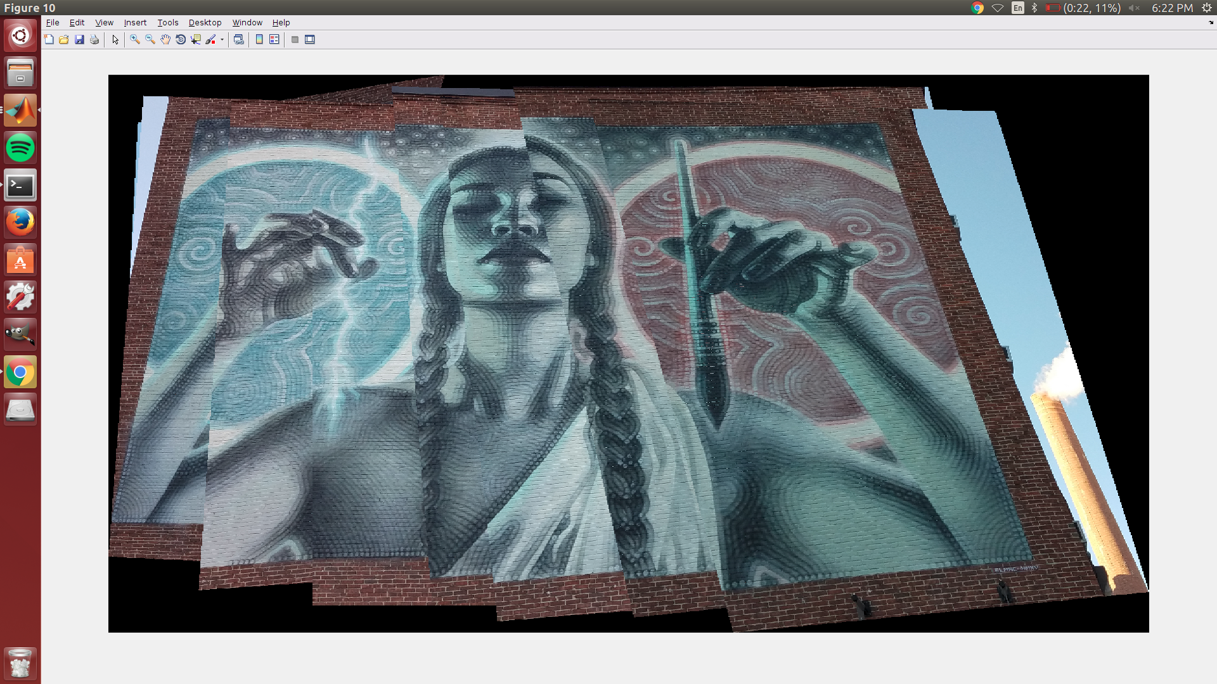
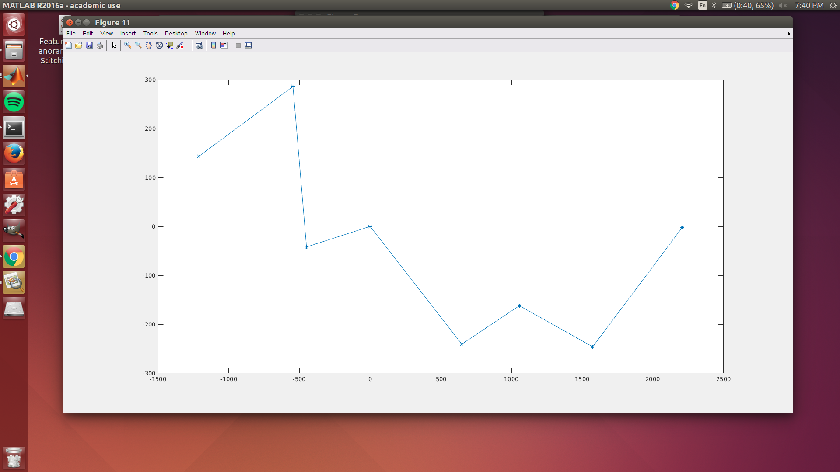
Art Mural
This image was taken from an angle below the Mural at an angle of 45 deg to ground. The images were overlapped similarly to the Latino building. Heavy overlapping helps with the images.

Slide 6
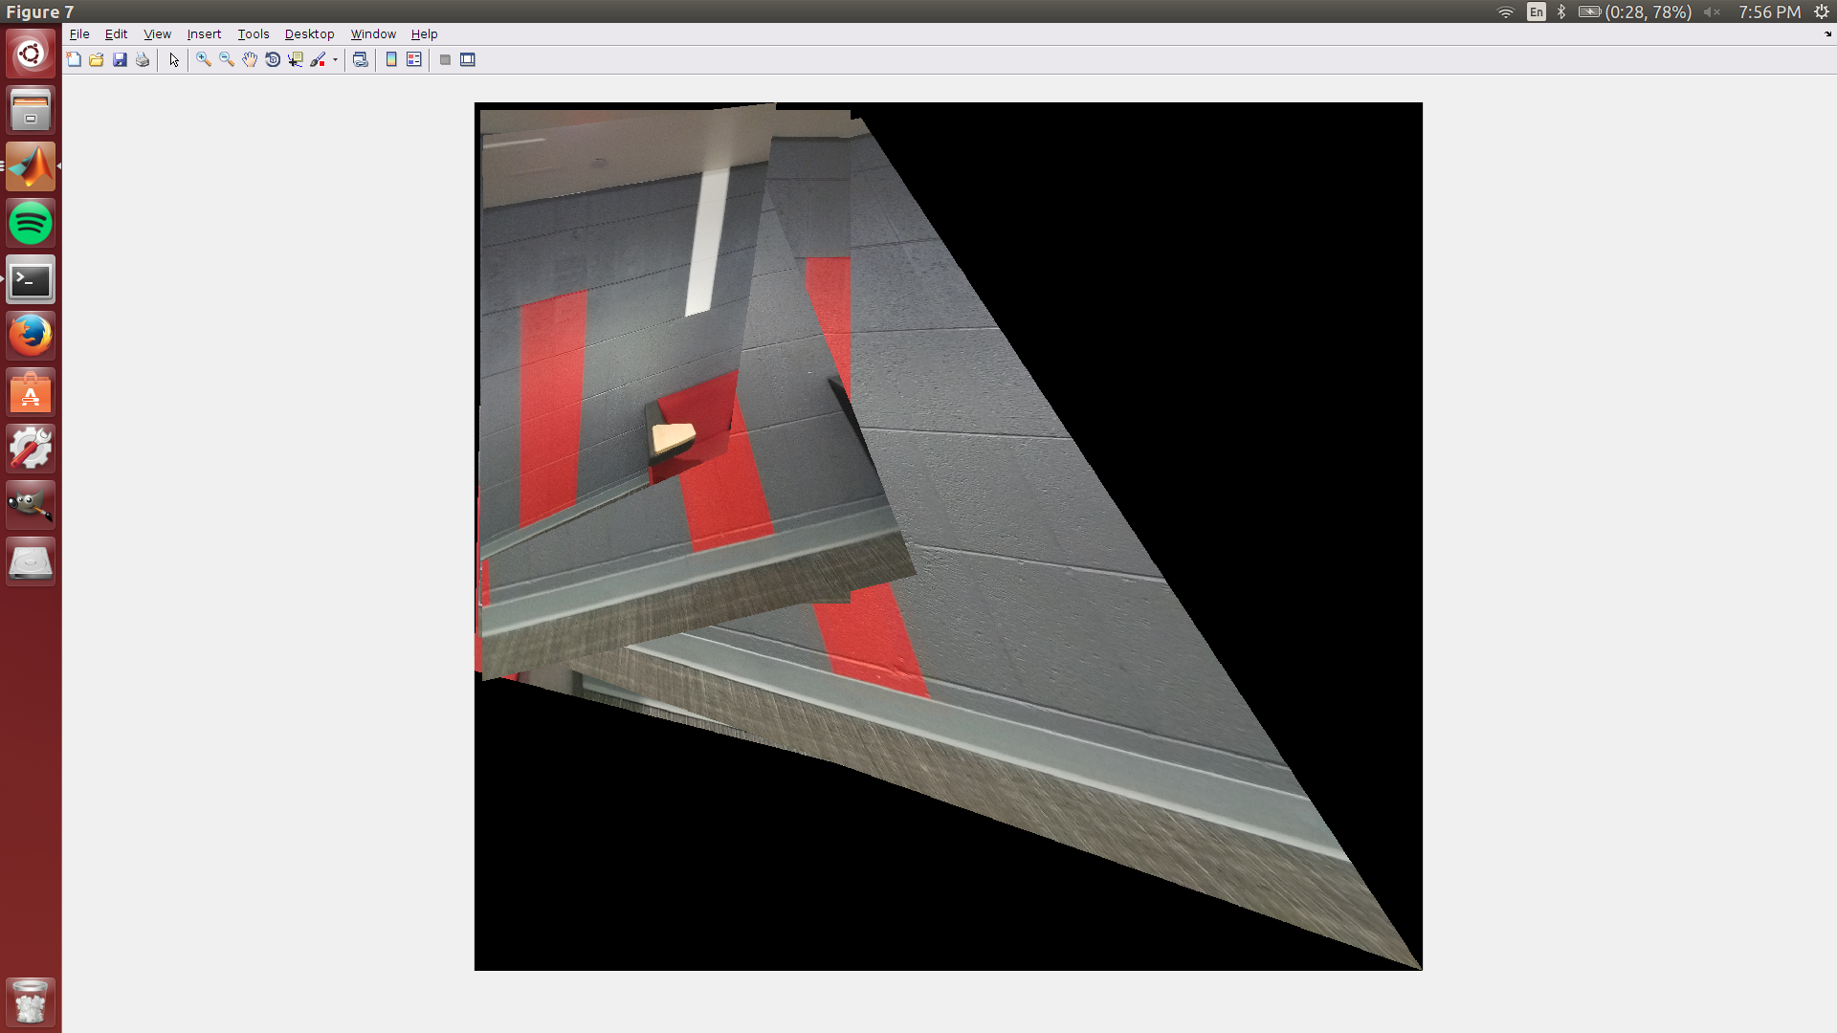
Cinder Block
Here the image panorama doesn't get completed as the pattern repeats and the computer cannot recognize the pattern. Hence the mosaic comes out very distorted and the algorithm cannot work in the regard for similar pattern.

